Slide 1
Argument Analysis: Claim – Reason - Foundation

Slide 2
Argument Analysis
Consider this argument:
Because average temperatures across the globe have been rising steadily over the last 100 years, Americans should reduce the amount of CO2 they are putting into the atmosphere.
What seems to be the main argument here? What are you being asked to do or believe?
What is the reason it’s being argued?
What underlies the argument (issues, motives, conversations)?

Slide 3
Argument Analysis
Doing argument analysis is much like dissecting a frog or explicating a poem.
You are breaking down an argument into parts and seeing how those parts interact.
Just like you need some vocabulary to describe the interior of a frog: spleen, esophagus, and kidney, you need some vocabulary to describe what you’re seeing in an argument. That’s what we’re going to talk about here.

Slide 4
Argument Analysis
Academic Writing is broken down into three basic areas (Assertion, Context, Evidence)—
Argument Analysis takes one of those areas—The Assertion—and breaks it down into three parts.
Assertion Claim
Context Reason(s)
Evidence Foundation(s)

Slide 5
Argument Analysis
We have a nifty formula for breaking down assertions into claims – reasons – foundations
When reading an argument, apply the following:
Claim Reason(s) Foundation(s)
(X “because” Y) Z
Operational Words (these are really helpful when doing analysis)
“based on”
“enabled by”
“rooted in”

Slide 6
Argument Analysis
Even with this formula, however, argument analysis can be difficult.
Sometimes, the main claim might be hard to find. Sometimes, there is more than one claim. Sometimes, there is no explicit claim; one has to be inferred.
Sometimes, it’s hard to separate reasons and claims from one another.

Slide 7
Argument Analysis
Sometimes, the main claim might be hard to find.
It could be delayed until the end of the reading. http://www.esquire.com/blogs/politics/whitewater-flash-pass-12403562
It might not be stated clearly. http://www.politico.com/blogs/media/2012/10/nate-silver-romney-clearly-could-still-win-147618.html

Slide 8
Argument Analysis
Sometimes, there is more than one claim, and it is difficult to tell which one the author intends as the most important.
http://www.csmonitor.com/Commentary/Opinion/2009/0910/p09s02-coop.html

Slide 9
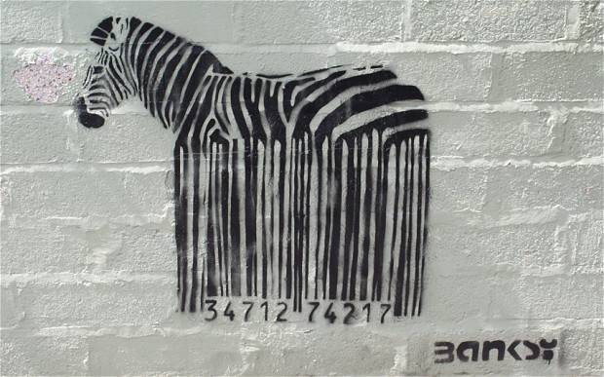
Argument Analysis
Sometimes, there is no explicit claim; one has to be inferred. This is especially true with things like images.

Slide 10
Argument Analysis
So, what we see is that argument analysis, at it’s most basic level…finding the main argument…can be difficult and an exercise in trial and error. You may have to occasionally treat it like a scientific experiment in which you begin with a hypothesis and test the hypothesis to see if it’s true.
Argument analysis does, however, get easier the more you do it.

Slide 11
Argument Analysis
Claim
Reason
Foundation
A Claim is the main argument. It’s the thing the writer wants you to do or to think.

Slide 12
Argument Analysis
The very first thing to do when beginning an analysis is to put away your biases (at least as much as you can).
It doesn’t really matter what you think about the issue or the argument; in fact, you may disagree entirely, or may agree entirely with the argument. You should put that aside.
When all you can think about is your own perspective on an argument, you blind yourself to the actual argument before you.

Slide 13
Argument Analysis
The second thing you need to do when beginning an analysis is to actually observe what is on the page (or on the screen).

Slide 14
Argument Analysis
“Undocumented students are a population defined by limitations. Their lack of legal residency and any supporting paperwork (e.g., Social Security number, government issued identification) renders them essentially invisible to the American and state governments. They cannot legally work. In many states, they cannot legally drive. After the age of 18, they cannot travel on airplanes without government issued identification.”
Arriola and Murphy, from “Defined by Limitations.” Journal of College Admission, 2010
What is the claim here?
What are the reasons?

Slide 15
Argument Analysis
“Undocumented students are a population defined by limitations. Their lack of legal residency and any supporting paperwork (e.g., Social Security number, government issued identification) renders them essentially invisible to the American and state governments. They cannot legally work. In many states, they cannot legally drive. After the age of 18, they cannot travel on airplanes without government issued identification.”
Arriola and Murphy, from “Defined by Limitations.” Journal of College Admission, 2010
What is the claim here?

Slide 16
Argument Analysis
“Undocumented students are a population defined by limitations. Their lack of legal residency and any supporting paperwork (e.g., Social Security number, government issued identification) renders them essentially invisible to the American and state governments. They cannot legally work. In many states, they cannot legally drive. After the age of 18, they cannot travel on airplanes without government issued identification.”
Arriola and Murphy, from “Defined by Limitations.” Journal of College Admission, 2010
What are the reasons?

Slide 17
Argument Analysis
Claim
Reason
Foundation
A Reason is a statement presented in justification or explanation of a belief or action.

Slide 18
Argument Analysis
The best way to figure out what the reasons of an assertion is to use the word “because” after a claim.
The band Radiohead is great.
Radiohead has consistently put out great albums (Amnesiac notwithstanding).
Ok, Computer is considered one of the best three albums of the 1990s.
The band has an uncompromising vision for its music.
Radiohead is great “because” it has consistently put out great albums, and “because” Ok, Computer is one of the best albums of the 90s, and “because” it has an uncompromising vision for its music.
What logically follows “because” allows us to find the reasons the writer is using to make his or her point.

Slide 19
Argument Analysis
The added benefit to this method of finding reasons is that it allows one to distinguish between reasons and non-reasons.
As a lifelong football fan, I've been painfully aware of its medical risks since the incriminating media reports began to appear over a decade ago. But as a Lane Technical College Prep High School graduate who once covered its games for the school newspaper, the article about Drew Williams hit even closer to home.
Neither the text of this article nor the human interest follow-up on Lane's subsequent game mentioned a game score or even Williams's playing position. That was the proper perspective. Hopefully the American public can form a predominant “football is bad for you” perspective and phase out the game forever before too many more of our young people are hurt. With as many entertainment options as we have today, it seems we could find an alternative to fill our autumn weekends, without possibly voiding somebody's future in the process.
What is the main claim in the Letter to the Editor (Chicago Tribune)?
What reason or reasons does the writer give?

Slide 20
Argument Analysis
Claim: Americans should take a “football is bad for you” perspective and end the game as a whole.
Reasons: “because” Too many young people are getting hurt playing.
“because” There are other options for entertainment.
“because” Players are not only getting hurt but getting hurt badly enough to cause irrevocable harm.
As a lifelong football fan, I've been painfully aware of its medical risks since the incriminating media reports began to appear over a decade ago. But as a Lane Technical College Prep High School graduate who once covered its games for the school newspaper, the article about Drew Williams hit even closer to home.
Neither the text of this article nor the human interest follow-up on Lane's subsequent game mentioned a game score or even Williams's playing position. That was the proper perspective. Hopefully the American public can form a predominant “football is bad for you” perspective and phase out the game forever before too many more of our young people are hurt. With as many entertainment options as we have today, it seems we could find an alternative to fill our autumn weekends, without possibly voiding somebody's future in the process.

Slide 21
Argument Analysis
Claim
Reason
Foundation
A Foundation is the set of beliefs, ideas, arguments, and history that an assertion assumes in making the argument.

Slide 22
Argument Analysis
In the analytical scheme we’re using, one can get to the foundation by using the operating words, “based on, enabled by,” or “rooted in.”
Radiohead is a great band “because” it has an uncompromising vision, and this claim is “based on” the idea that great artists are not swayed by public opinion but by their own inner way of seeing their art.
Foundations are often arguments themselves that have their own reasons and foundations as in the previous example.
In fact, people might argue against the assertion at the foundational level:
That an artist must have great artistic “vision” (an undefined term here), is arguable. Did Frank Sinatra or Sarah Vaughn, artists who did not write but only sang, have vision or merely style and talent? Are style and talent the same as vision? What about Britney Spears or Miley Cyrus?

Slide 23
Argument Analysis
After finding the main claim, working out the foundation is the hardest part of this analytic system.
Remember that there may be many foundations (some, occasionally, that conflict); however, as Steven Toulmin (on whose system this is a simplification of) noted of arguments, many times the arguments back and forth happen on the level of the foundation, so foundations are very important to figuring out arguments.

Slide 24
Argument Analysis
Discuss the possible foundations for the following arguments:
The Chicago Cubs should never win the World Series because then the team would lose its mystique of perennial underdog.
Underprepared students who have to take a number of remedial courses should not be allowed to enroll in a 4-year university until they have the ability to take regular, credit-bearing courses because it is unfair to students who have adequately prepared for the university.
Sesame Street has been one of the worst influences on American education because it teaches that education is entertainment.

Slide 25
Argument Analysis
Wait! Now remember that your personal opinion of the argument is not important at this point. The job is to analyze the arguments’ foundations objectively first.
The Chicago Cubs should never win the World Series because then the team would lose its mystique of perennial underdog.
Underprepared students who have to take a number of remedial courses should not be allowed to enroll in a 4-year university until they have the ability to take regular, credit-bearing courses because it is unfair to students who have adequately prepared for the university.
Sesame Street has been one of the worst influences on American education because it teaches that education is entertainment.

Slide 26
Argument Analysis
A final text to look at:

Slide 27
Argument Analysis
First, we need to see what’s on the screen—look at what’s actually there.
It appears to be someone pointing a gas pump hose at somebody else’s head. In the background is a green, yellow, and white graphic—resembling a flower.
Okay, that’s what’s there…kind of…

Slide 28
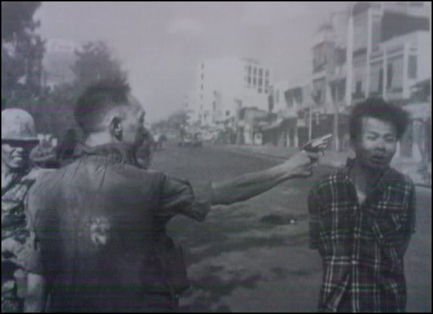
Argument Analysis
The silhouettes are the shape of a Vietnamese colonel executing a Vietcong prisoner. A pretty famous, graphic, image from the Viet Nam War.
The flower graphic is a part of British Petroleum’s logo.
Of course, the colonel’s pistol has been replaced by a gas pump handle.

Slide 29
Argument Analysis
What does the creator of this image seem to be arguing? What do you think the claim is? Do the images add up to an argument?
Because there are no stated reasons (obviously, there are no words), can you infer some possible reasons for the claim?
What kinds of ideas underlie the argument in this image?

